Slide 1


Job Market Analysis
Analyzing Job Demand, Salary Trends, Education Requirements, and In-Demand Skills
Data Trends
Job Demand
Salary Insights
In-Demand Skills

Slide 2





Project Objective & Dataset Overview
Project Objectives
Dataset Overview
Analyze Data Science job-market demand and distribution.
Identify geographical locations with maximum career opportunities.
Pinpoint high-demand industries and top hiring companies.
Primary attributes captured in dataset:
Compare compensation levels across states and job titles.
Evaluate salary variance against candidate education levels.
Extract skill profiles required for various data roles.

Slide 3




Data Preparation Using Power Query
Raw Data
Validation
Text & Salary
Skill Unpivot
Initial Ingestion
Type & Missing (-1)
Cleaning & Deduplication
Analysis-Ready Model
Transformation Steps
Data Modeling & DAX
•
Validated data types across all 42 attributes for modeling accuracy.
•
Unpivoted skill columns into a dedicated skill-granularity table.
•
Established a 1-to-Many relationship between main jobs and skill table.
•
Standardized missing value codes (imputed/filtered -1 tags).
•
Cleaned text fields (removed ratings from company names, parsed states).
•
Developed custom DAX measures for dynamic salary and count metrics.
•
Eliminated duplicate job records and verified salary column ranges.
•
Structured data model optimized for Power BI visual reporting.

Slide 4
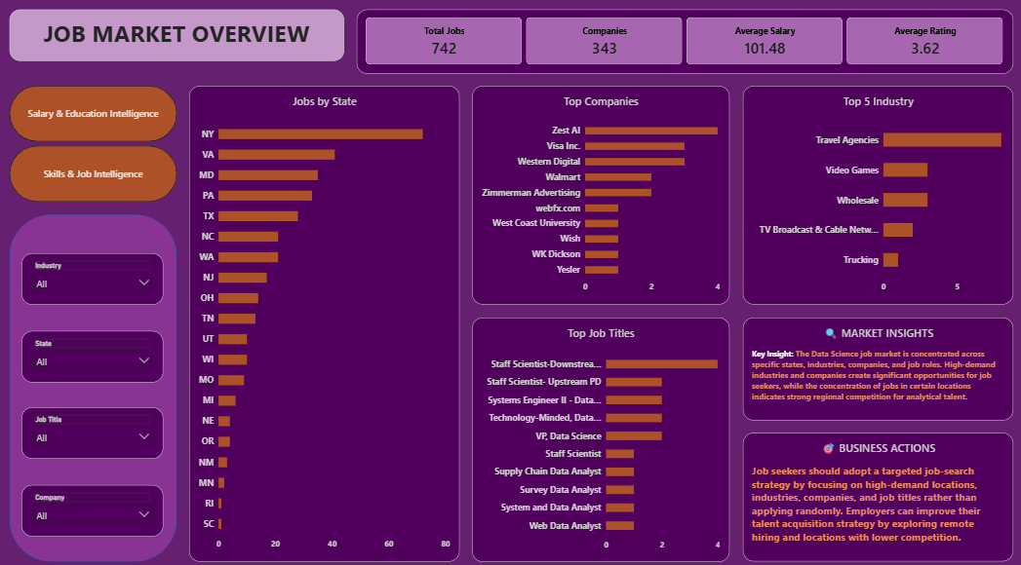

Job Market Overview
Strategic Recommendation
Job seekers should strategically target high-demand geographic regions, key growth industries, and top-hiring firms rather than taking a broad, untargeted application approach.

Slide 5
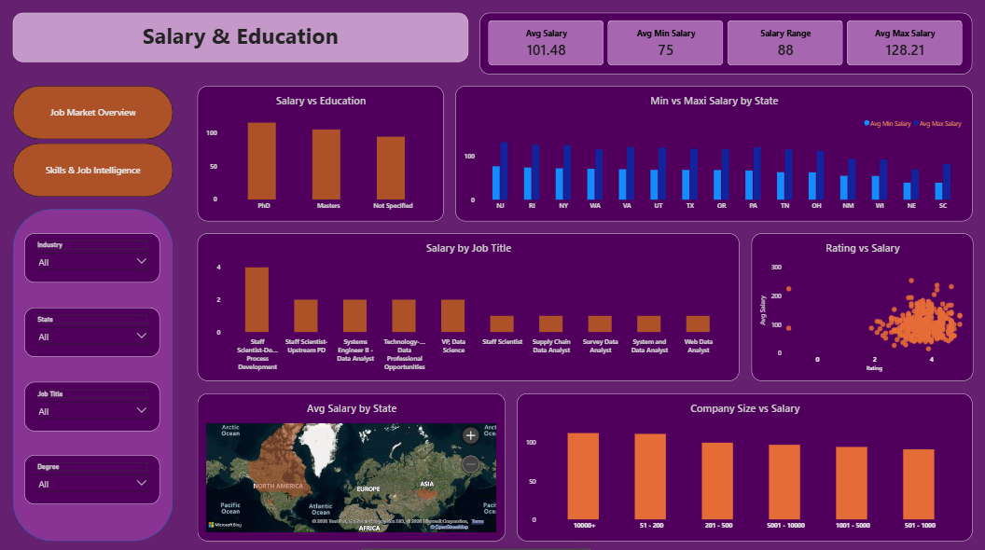

Salary & Education Analysis
Career Strategy
Career choices should balance compensation potential with job availability, location, skill prerequisites, and long-term career growth opportunities.

Slide 6
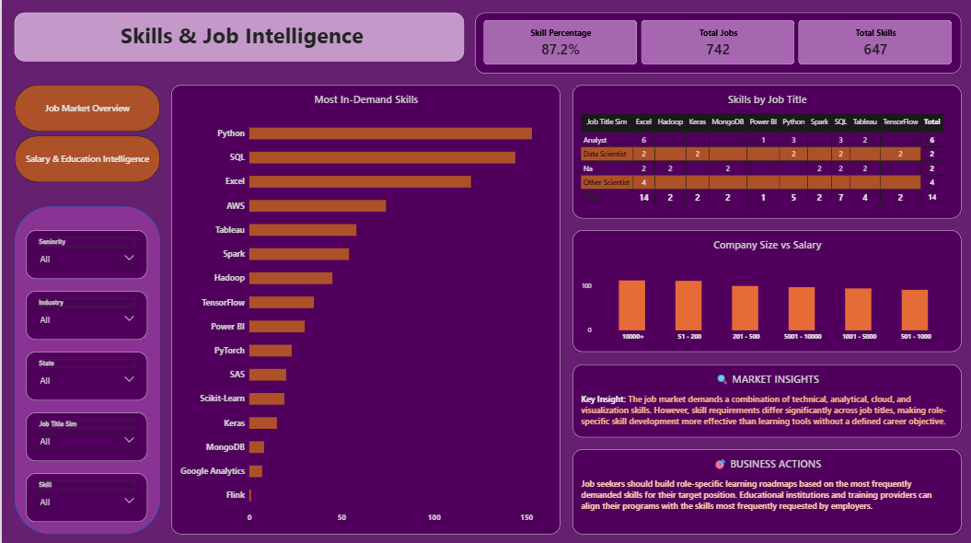

Skills Analysis & Recommendations
Candidate Roadmap
Grow Career
Target Role
Analyze Market
Learn Tools
Build Projects

Slide 7
Thank You!
Analyzing the job market through a data-driven lens enables candidates to make informed career decisions and helps organizations adapt to evolving talent needs.

